Slide 1





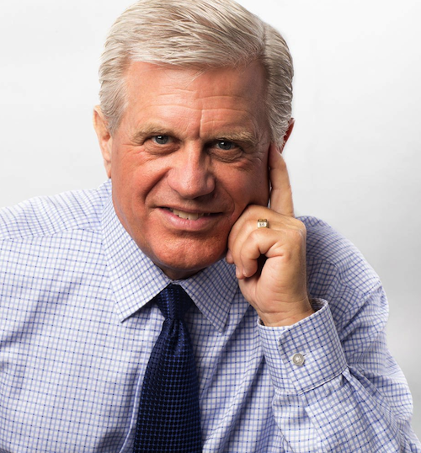











Mortgage Lending 2021
TITLE SPONSOR
PLATINUM SPONSOR
Invite a Realtor, Escrow Officer or other industry professional
Come listen to this 47-year industry veteran and founder of “Lykken on Lending” talk about business strategies that result in competitive market advantages.
Register early – space is limited
David Lykken
Consultant | Coach
GOLD SPONSOR
Featured on
SILVER SPONSOR
Please note different day
2019 Post Oak Blvd Houston, TX 77056
Date: FRIDAY, September 24, 2021
11:30 -12:00pm 12:00 – 1:00pm
REGISTRATION LUNCHEON
Member fee: $30 Future Members: $45
RSVP and Online Payments can be made at www.ghamp.com

